Slide 1

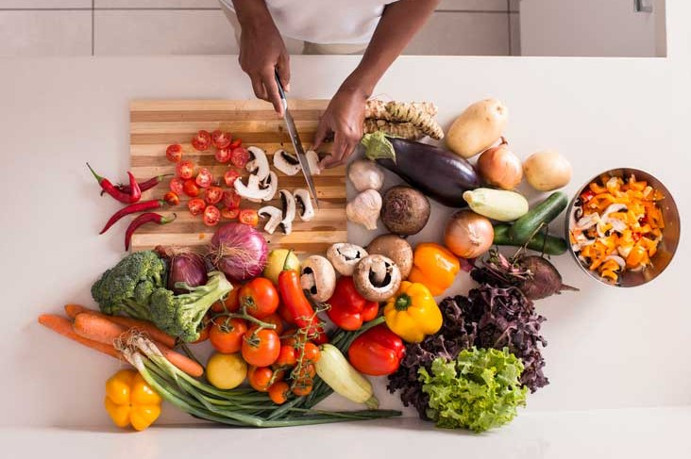
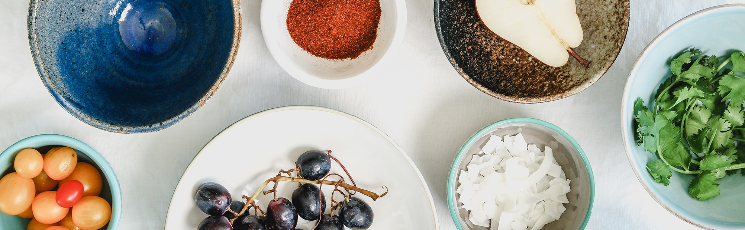
PROMOTING HEALTHY EATING & BALANCED DIET
with Re-Define Me
Professor: Henry Wong
Computer Science Project
Course : CS692
Team: 2 (Tiny Coders)

Slide 2
AGENDA
Improvements from professor feedback
Team Members
Problem Statement
Project Description
Personas
Minimal Viable Product (MVP)
Technologies
Architecture Diagram
Sprint 4 Recap
Product Backlog
Sprint Backlog
Metrics
Retrospective​
Sprint 6
Project Demo
Application Demo
Git-hub link
Live Application Demo

Slide 3

Meet the team
MEET THE TEAM
Sathwik Mudenti
Varun Reddy
Naresh Babu Chinta
BACKEND DEVELOPER 1
BACKEND DEVELOPER 2
QA/TESTER

Slide 4
Meet the team
MEET THE TEAM
Dharini Maanasa
Brunda Reddy
FRONTEND DEVELOPER
DBA

Slide 5


PROFESSOR FEEDBACK
Improvements Made
Professor feedback
Professor suggested us to update project description.
Change Architecture diagram
Change the format of product backlog, User stories and acceptance criteria.
Change metrics.
Change the format in which we write our test cases.
We Updated our Project description.
We Changed our architecture diagram and added other diagrams too.
We made changes to product backlog and user stories .
We updated metrics.
We changed the format of our test cases.

Slide 6

TEAM WORKING
AGREEMENT

Slide 7

TEAM AGREEMENT
All the members of the team are expected attend meetings that happen twice over the week and in case of absence person must contact the teammates for the information.
Tasks are to be divided between each member of the team and the members of the team should stay committed to the deadlines of the tasks that they are assigned.
Each member of the team are expected to brainstorm and come up with unique ideas.
Making sure every teammate providing the equal amount of contribution and providing feedback within the team so that they can perform better.
In case if any person in the team faces issues the he should contact other persons in the team.
Team:
1)Maanasa Dharini
2)Sathwik Mundeti
3)Naresh Babu Chinta
4)Varun Reddy Duggimpudi
5)Brunda Reddy

Slide 8
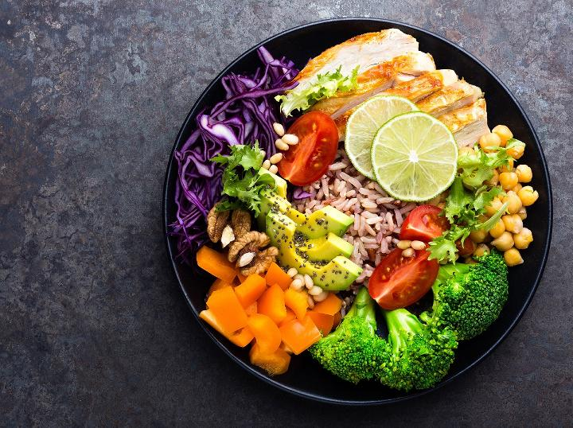
PROBLEM STATEMENT

Slide 9
PROBLEM STATEMENT
A health casual who doesn't particularly care about calorie counting needs a way to get a good idea of how (healthily?) they're eating. Most of the fitness apps focus on tracking calories but they don’t include the feature that helps them to know calories from the food that they are eating, and we are trying to solve it using deep learning.
Food classification is a challenging problem due to the large number of food categories. Calorie estimation that helps in calculating number of calories in a recipe.Food classification brings out ingredients in a recipe and maintenance calories that help in calculating number of calories based on age, height and activity and recipe generation that helps us to create recipe from the set of inputs that we give are part of our project.

Slide 10
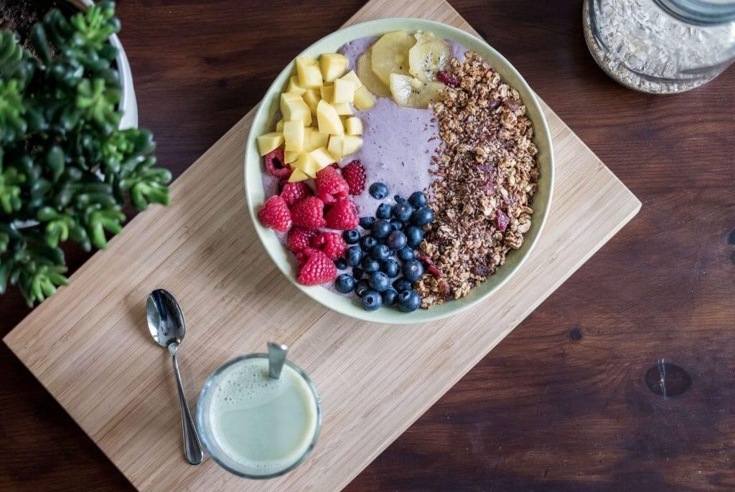
PROJECT DESCRIPTION

Slide 11
Project description

Slide 12
Project description
We want to provide a digital health and wellness web application designed to help users shed the pounds and get active, Nutrition Tracker, Water Tracker, Workout and Weight Tracker.
Operating from a freemium model, the platform offers users the opportunity to monitor and track their daily calorie intake, get personalized advice from a team of professionally qualified nutritionists and fitness experts and suggest proper diet flow to the user.Using deep learning techniques, we are trying to implement all these features into our application.

Slide 13
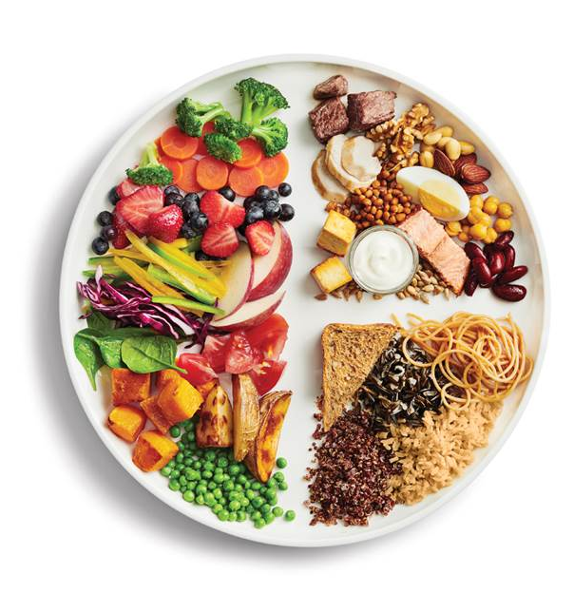
CALORIE ESTIMATION
A balanced diet is one that contains all the essential elements that the human body needs.
Carbohydrates, lipids, vitamins, minerals, proteins, fiber and water are all essential components in a well-balanced diet.
A nutritious, well-balanced diet lowers the risk of disease and enhances general health.
Formula to estimate calories - 0.24((fat * 37) + (protein*17) + (sodium *8) + (sugar * 17)) = Total calories.

Slide 14
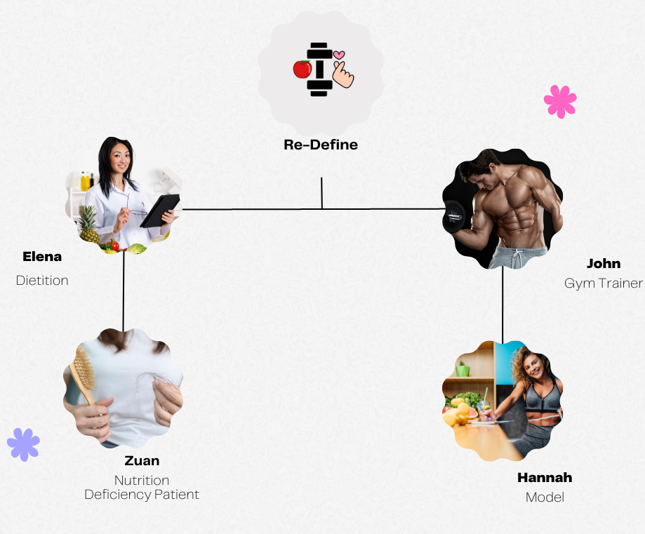
PERSONAS

Slide 15

Elena Dietitian 35 years
PROFILE
Name: Elena
Age: 32 years
Profession: Dietitian.
Graduation: She graduated with her doctorate from the University of Bridgeport School of Chiropractic.
Work Experience: She has spent over 5 years in the healthcare industry and has a patients for understanding human biomechanics and she is registered with the Commission of Dietetics Registration (CDR).
Interests: She loves long rides, cooking, Athletics and Human Performance.
Goals: Her goal is to collaborate with the top EHR system handling companies to update the EHR system and need to hire few faculty who helps her in maintaining the data of clients.

Slide 16
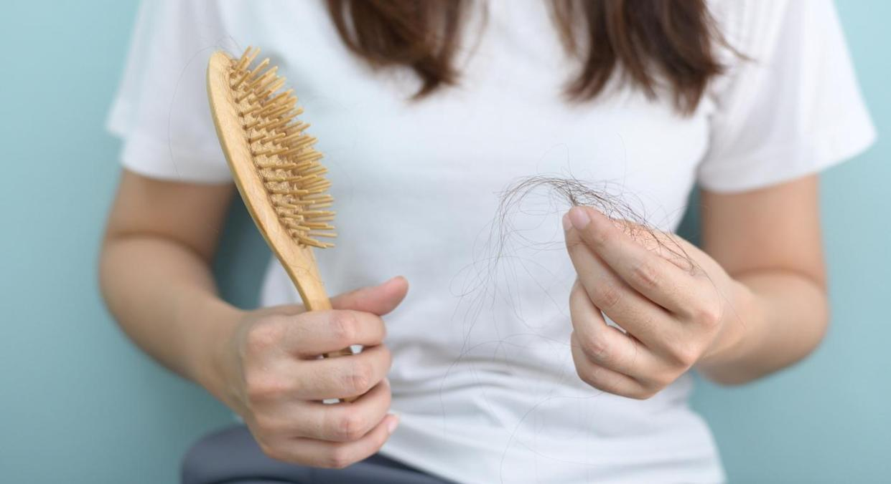
PROFILE
Name: Zuan
Age: 26 years.
Profession: Software Developer at Apple Inc.
Problem: She is suffering from Nutrition Deficiency, lactose intolerance, has signs of B12 and suffering from dry skin, severe hair fall.
Treatment: medication for malnutrition including supplementation, proper diet, lifestyle and eating disorder.
Work Pressure: It is difficult for Zuan to handle her job and the work pressure there due to hectic schedule.
Goals: As Calcium deficiency can reduce bone strength and lead to osteoporosis, which is characterized by fragile bones Zuan wants to take the supplements with food containing vitamins in order to maintain balance.

Slide 17
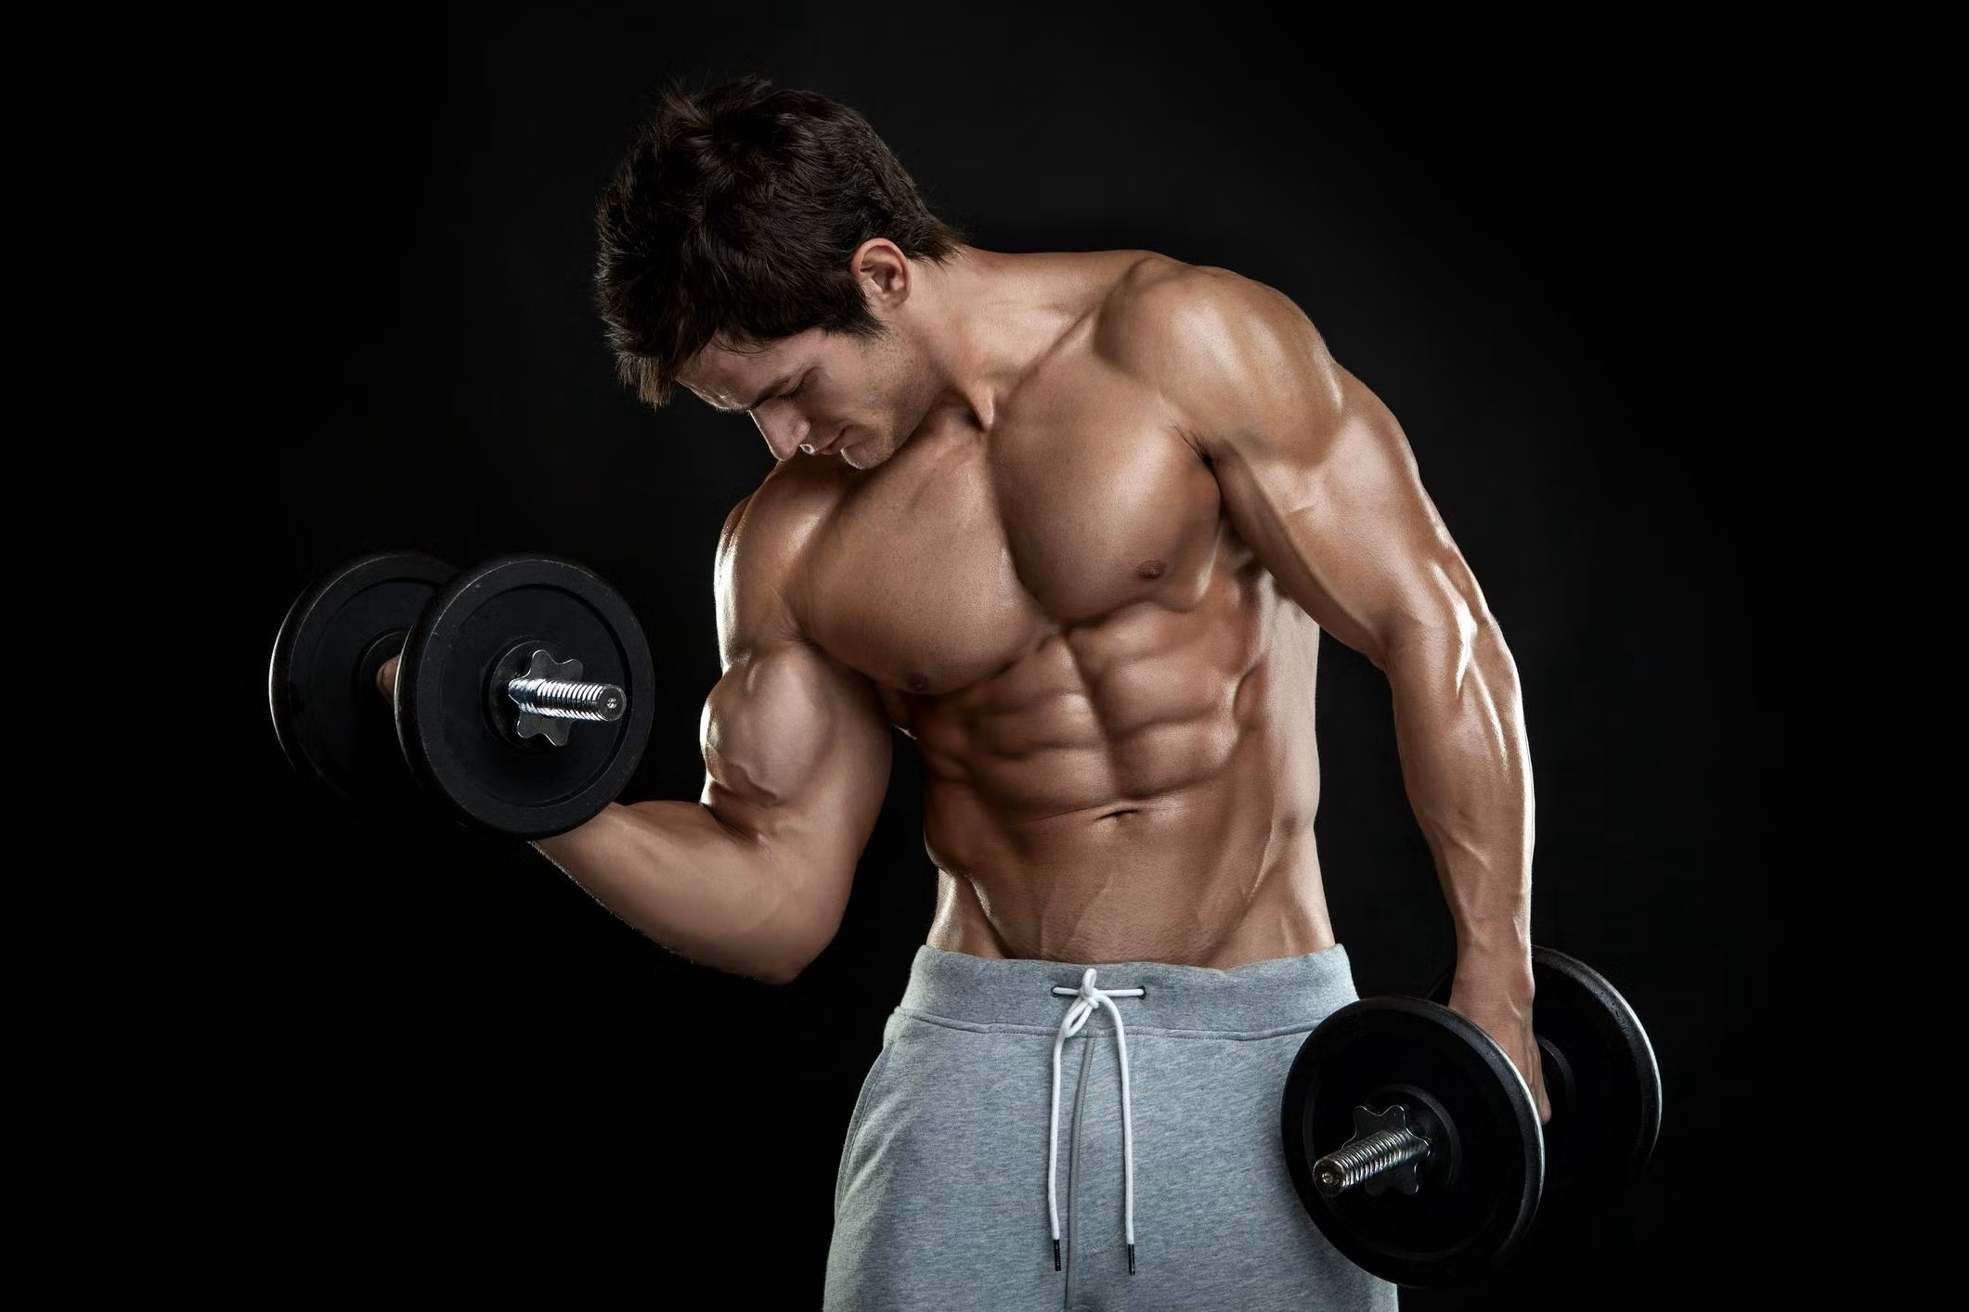
PROFILE
Name: Alex.
Age: 29.
Profession: Gym Trainer
Fitness Level/Rating: Best.
Experience: Alex is the head coach of Mighty transformation program. And his passion is to help people change their lives in the simplest and most realistic way. He believe everyone deserves the right to good health and to be happy with themselves inside and out.
Interests: Weights lifting, Dancing, Cycling, Volunteering, Hiking
Goals: Alex is mindful of what his clients eat is just as crucial as their routine, in order to bring in healthy life and health mind. He wants to become established fitness professional. He helps his client to reach their individual goals with unique diet plans.

Slide 18
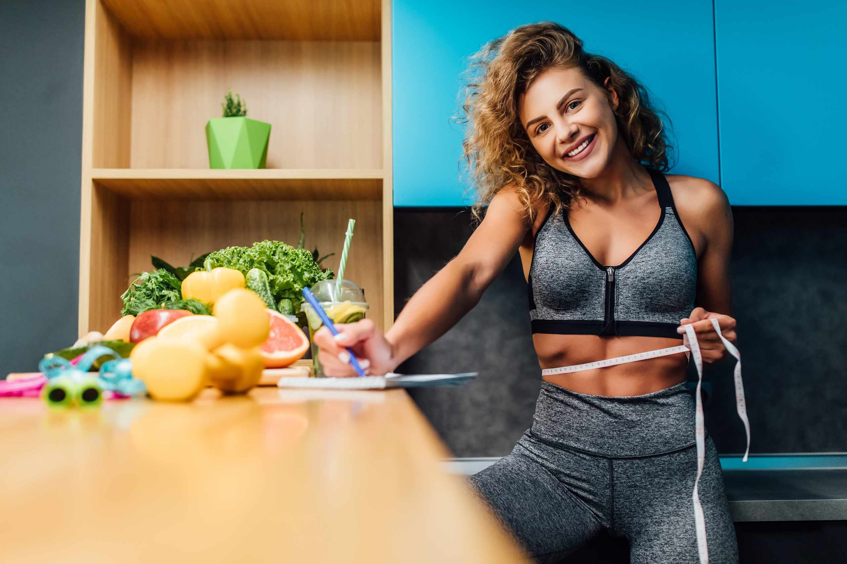
PROFILE:
Name: Hannah.
Age: 23.
Education: She has a high school diploma in Arts and music performing arts, with a course in modelling workshop from New York Fashion Institute.
Profession: Model and Youtuber with 1M subscribers..
Interests: Hannah enjoys exercising, yoga, attending fashion workshops, shopping and painting.
Difficulties: It is difficult for her to find work that pays well, dealing with criticism, and managing her time and finances.
Goals: Being a public figure, Hannah decided to maintain proper health along with a healthy and nutrition diet. She wants to be a role model in her pursuing career.

Slide 19
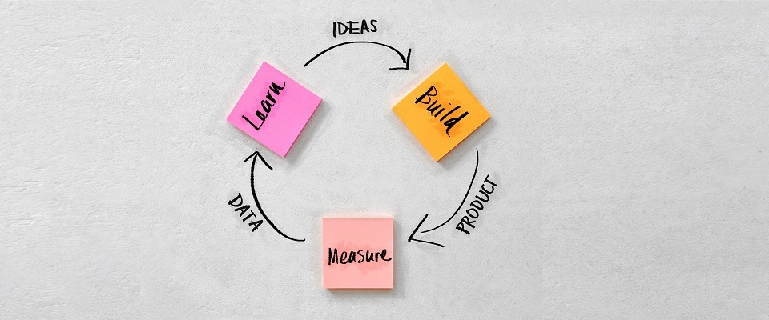
MINIMUM VIABLE PRODUCT

Slide 20
MVP: We have implemented following features as a part of our MVP.
HOME PAGE
USER REGISTRATION
FEATURES
CONTACT
SIGN UP
LOGIN
ABOUT
SIGN OUT
Display all the features on the home screen of the Application
Implement a particular feature called Maintenance Calorie Calculator using API.

Slide 21
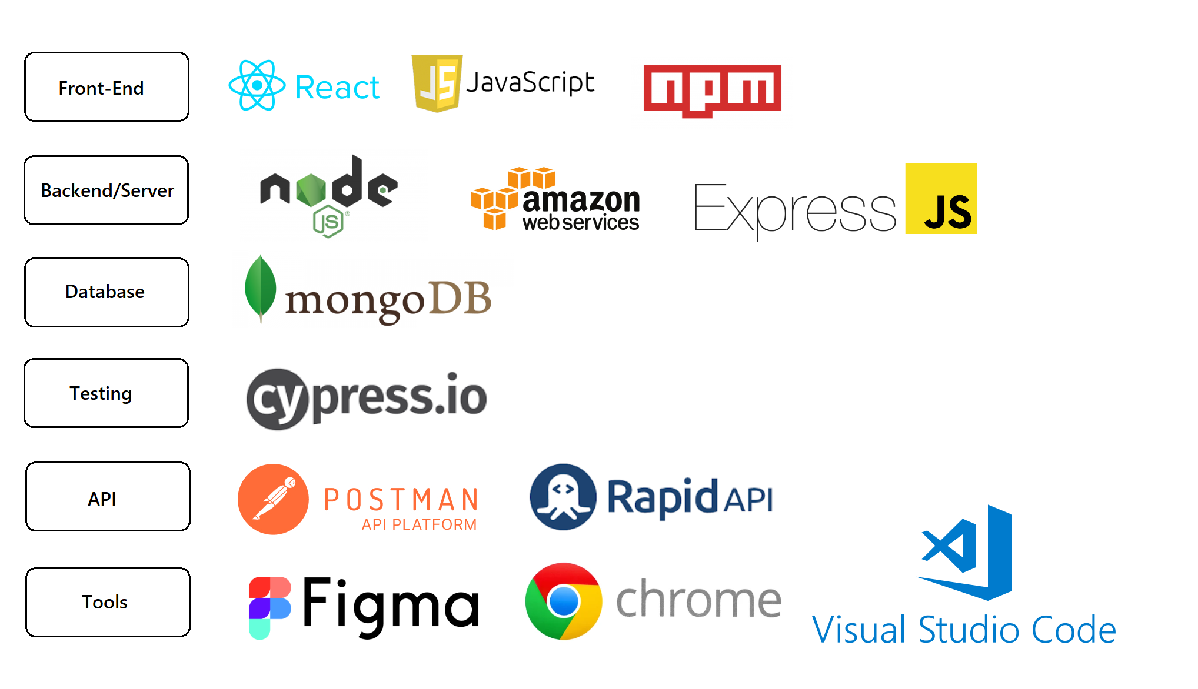
TECHNOLOGIES

Slide 22
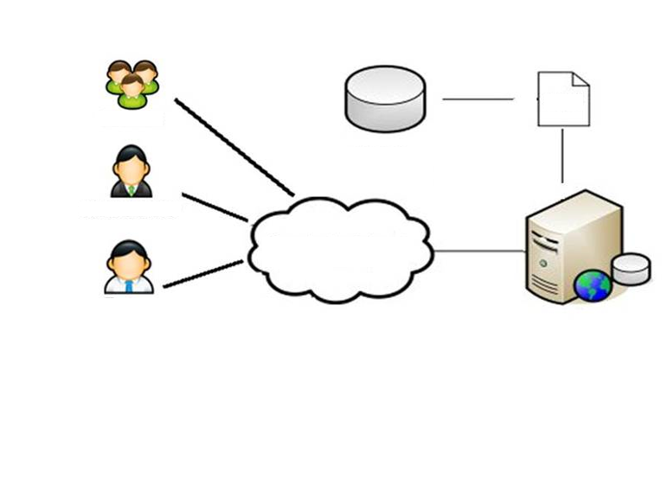
DIAGRAMS

Slide 23
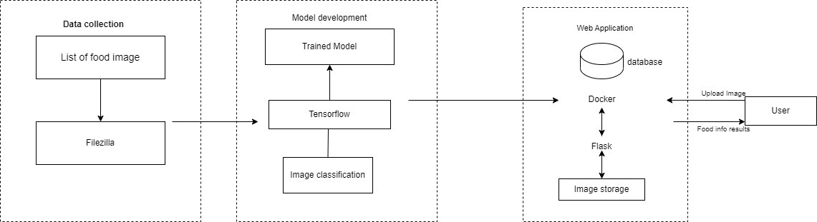
ARCHITECTURAL DIAGRAM

Slide 24
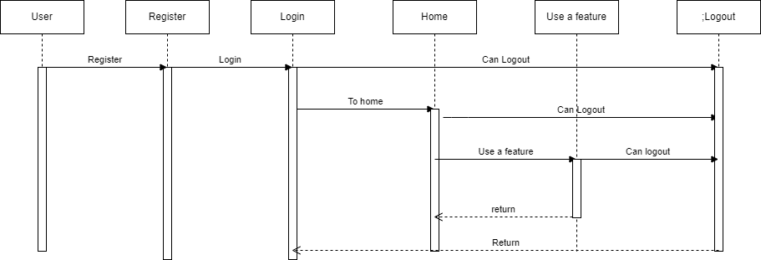
SEQUENTIAL DIAGRAM

Slide 25
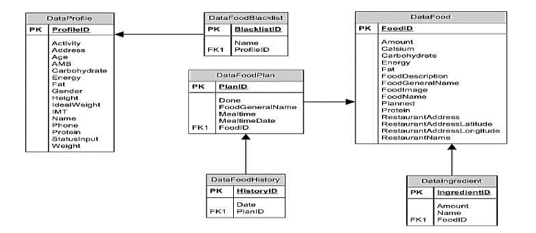
CLASS DIAGRAM

Slide 26
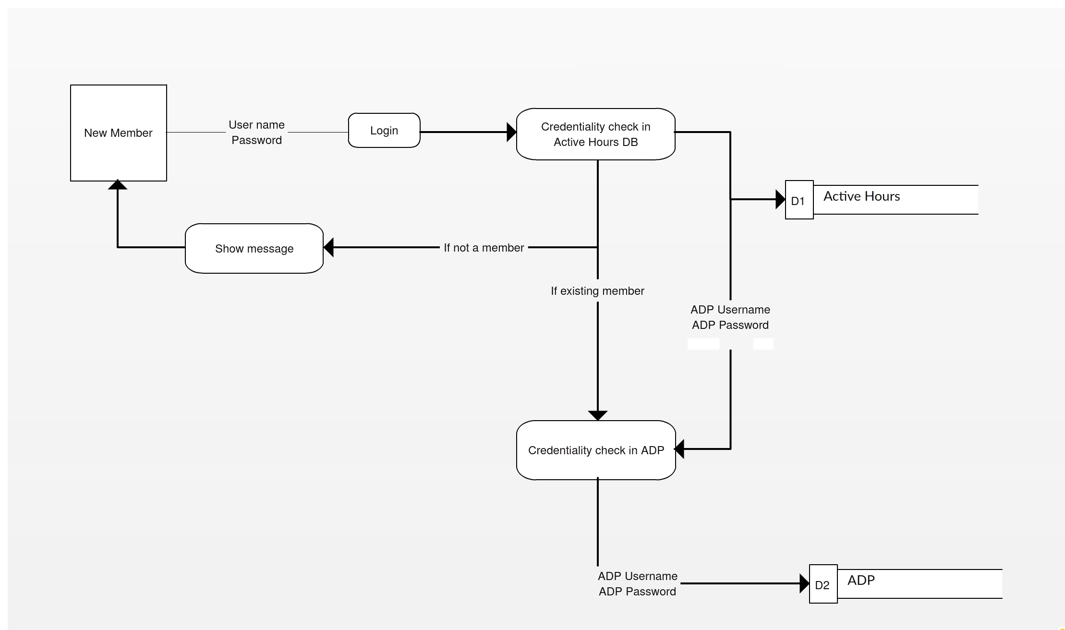
DATA FLOW DIAGRAM

Slide 27
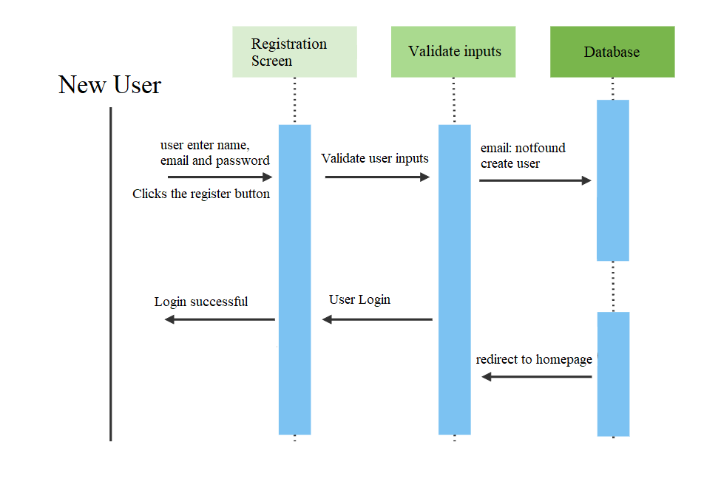
USER SEQUENCE DIAGRAM FOR NEW USER

Slide 28
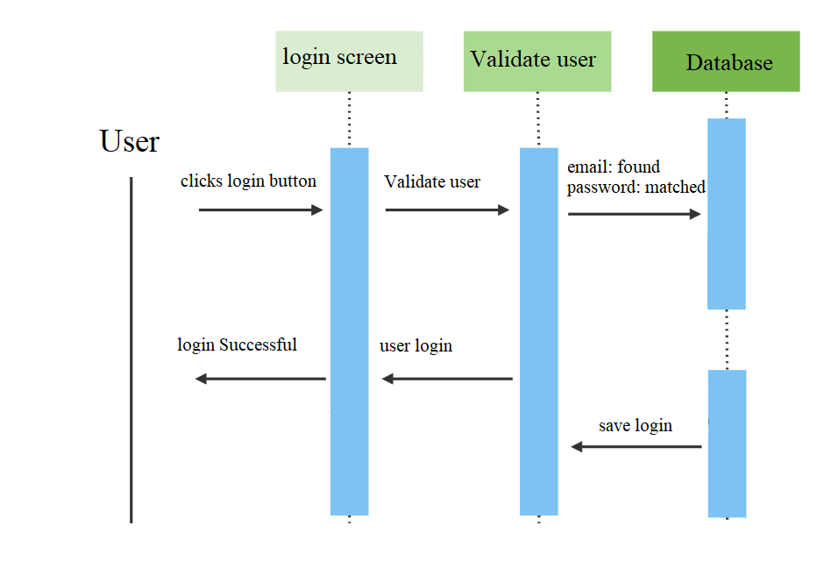
USER SEQUENCE DIAGRAM FOR EXISTING USER

Slide 29

SPRINT 4 RECAP

Slide 30
SPRINT 4 RECAP
Working on the tech paper.
Created a Sign/Login Page.
Added features for the Application
Worked on more user stories
Design backend & working on Database.

Slide 31
PRODUCT BACKLOG

Slide 32
Sprint5 backlog
Key | Issue Type | Name | Story Point
SAT-11 | Story | As a new user I want to Navigate through home page, features,about and find contact information. | 3
SAT-12 | Story | As a New user I should be able to scroll through the website and see all the features in it. | 5
SAT-13 | Story | As a user I should be able to share my information by writing name,goals and contact and submit the information | 3
SAT-14 | Story | User can Log-out from the webpage by pressing logout button | 3
SAT-18 | Task | Research on deep learning Algorithms | 5

Slide 33
STORIES PLANNED FOR SPRINT 5
Working on the tech paper.
Add more features to the application
Working on the Application Documentation
Complete Product Backlog for last sprint
New stories that are planned for next sprint

Slide 34
SPRINT BACKLOG & USER STORIES

Slide 35
User Stories for the Sprint

Slide 36
TEST CASES

Slide 37
Test case for sign-up

Slide 38
STORIES COMPLETED/INCOMPLETE

Slide 39
STORIES COMPLETED
Key | Issue Type | Name | Status
SAT-11 | Story | As a new user I want to Navigate through home page, features,about and find contact information. | complete
SAT-12 | Story | As a New user I should be able to scroll through the website and see all the features in it. | complete
SAT-13 | Story | As a user I should be able to share my information by writing name, goals and contact and submit the information. | Complete
SAT-14 | Story | User can Log-out from the webpage by pressing logout button | Complete
SAT-18 | Task | Research on deep learning Algorithms | Incomplete

Slide 40
METRICS

Slide 41
TEAM VELOCITY CHART
Story Point

Slide 42
TEAMS HISTORICAL VELOCITY (AVERAGE)
Story point

Slide 43
BURN DOWN CHART
Story Point
Dates

Slide 44
COMPLETED/COMMITTED RATIO
Story point

Slide 45

RETROSPECTIVE

Slide 46
What went well?
Meetings went according to the scheduled manner and the team members complemented each other well.
Priorities were clear and members took them into account.
The collaboration was great in our paired sessions.
We tried to finish the deliverable on time.

Slide 47
What didn’t go well?
Took more time to work on the login page and sign-up.
We did not add good number of user stories for the sprint.
A deadline on when things need to be completed and getting updates on it in every meeting was not met.
Did not finish hands on on deep learning algorithms

Slide 48
What we did to improve?
Need to improve time-management and spend more time to work on the deliverable
Finish research on deep learning algorithms and start focusing on sprint 6.
Each members need to take initiative and work on the deliverable .
.Team should focus on timely integration and deployment

Slide 49
SPRINT 6

Slide 50
Stories planned for sprint6

Slide 51

APPLICATION SCREENSHOTS

Slide 52
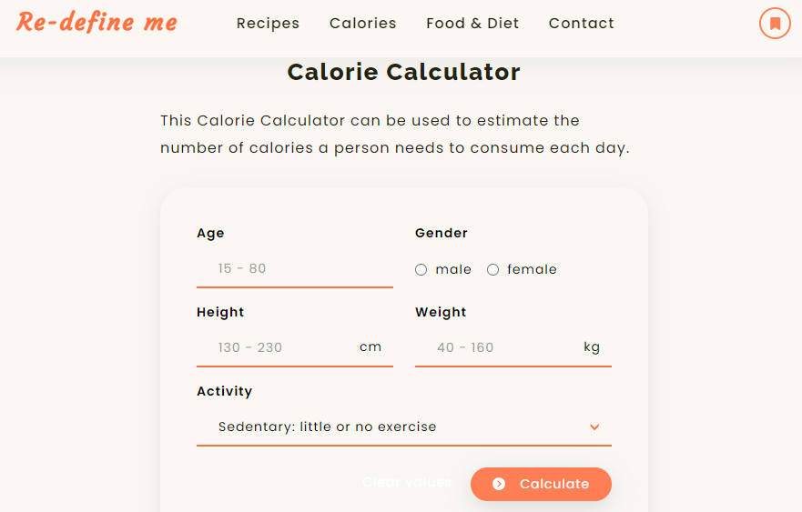

Slide 53
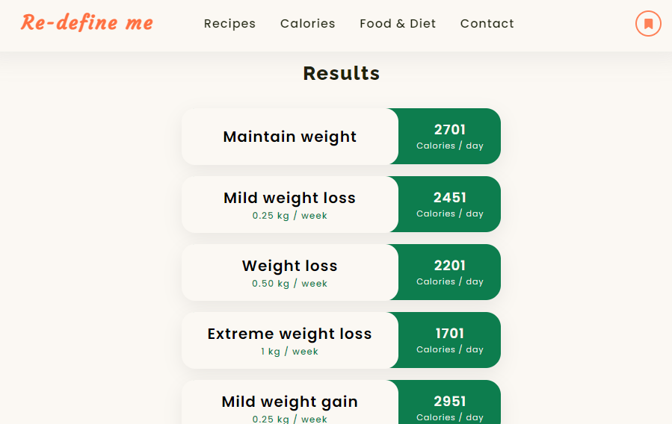

Slide 54
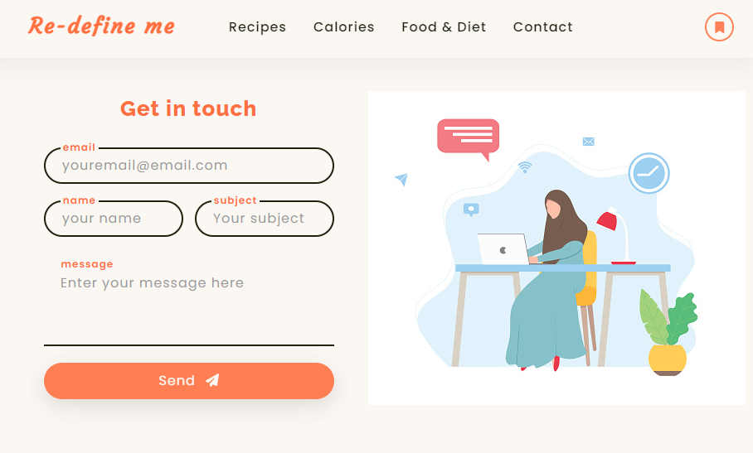

Slide 55
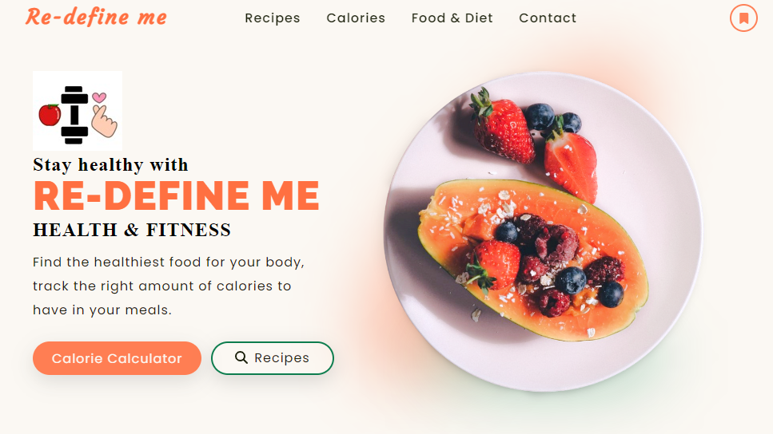
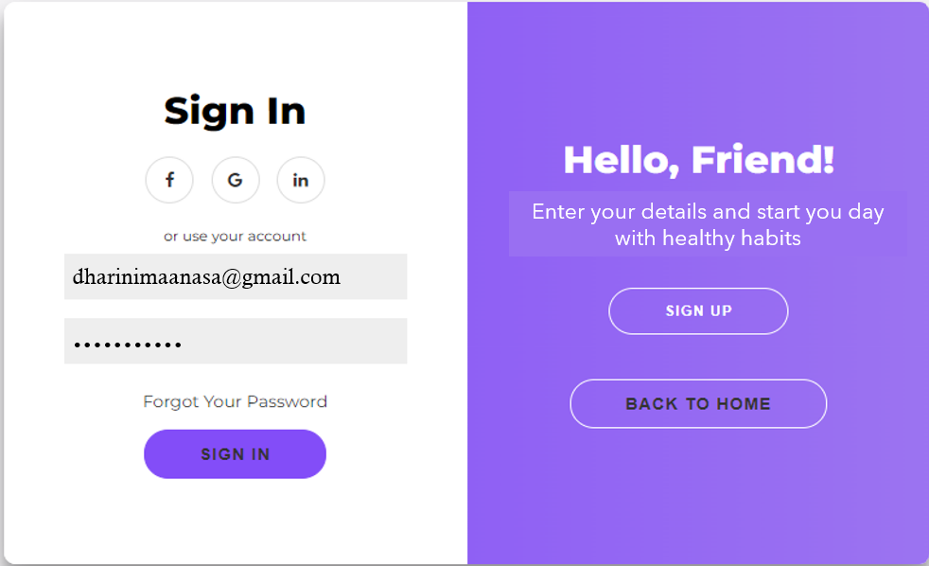

Slide 56
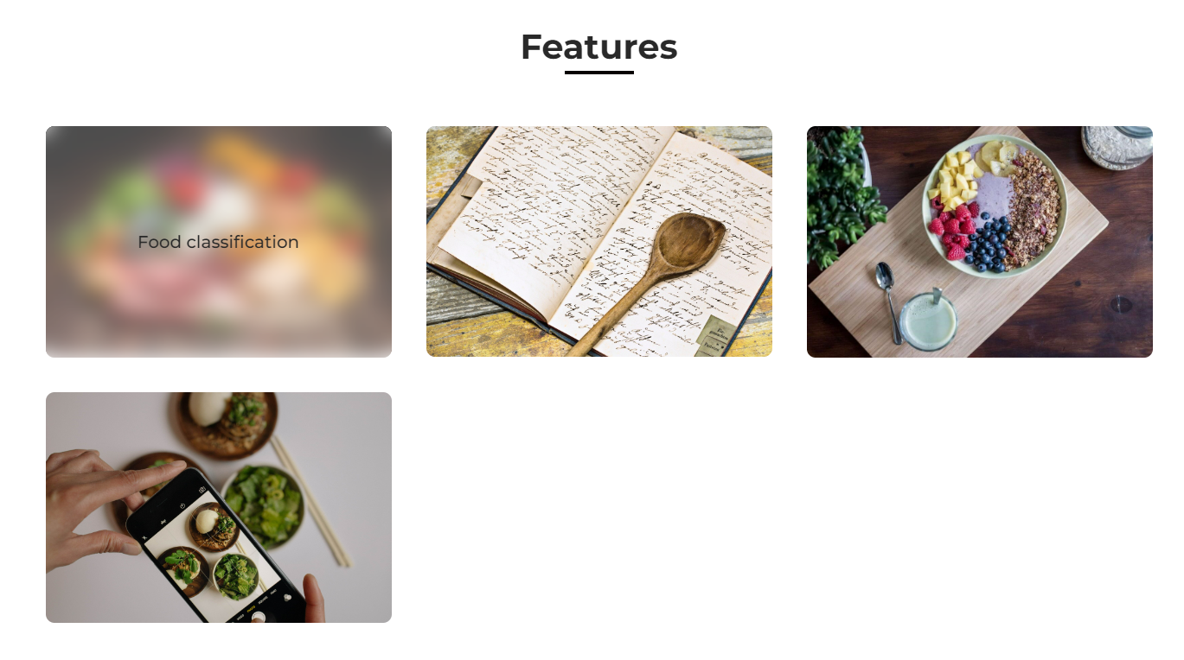

Slide 57

Git-hub Link
https://github.com/DhariniMansi/CS691.wiki.git

Slide 58
Happy eating
THANK YOU

